Slide 1
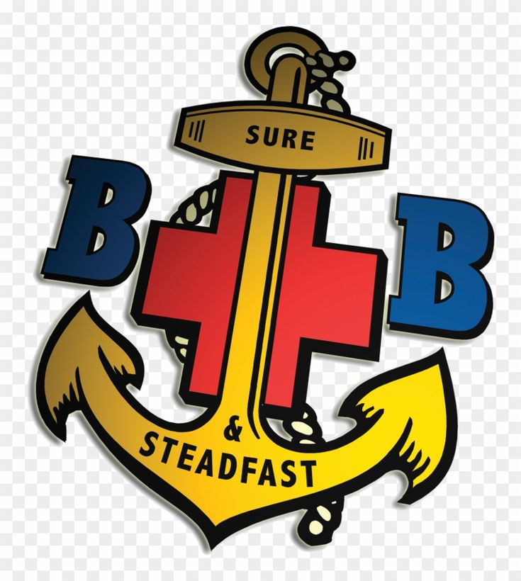

Welcome & Introductions

Slide 2
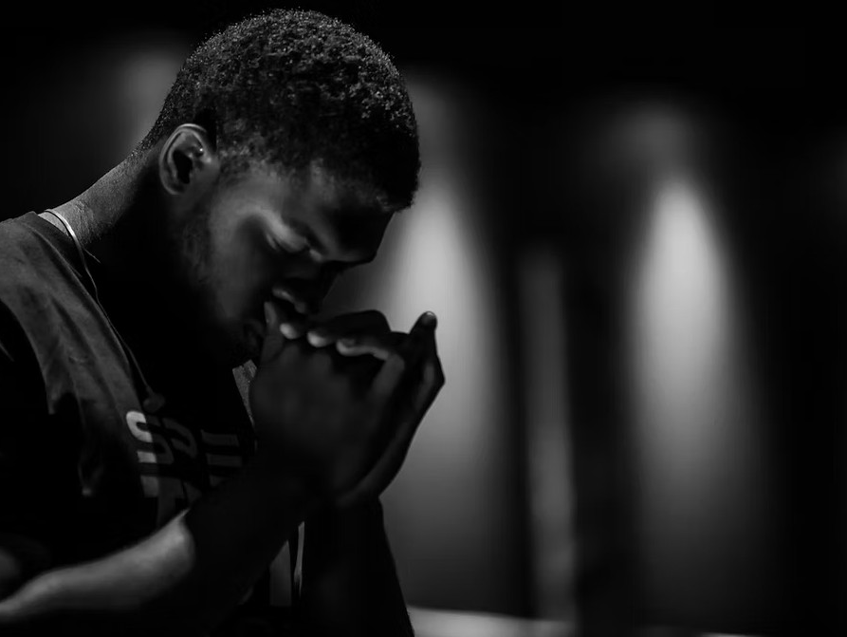
Opening Prayer

Slide 3
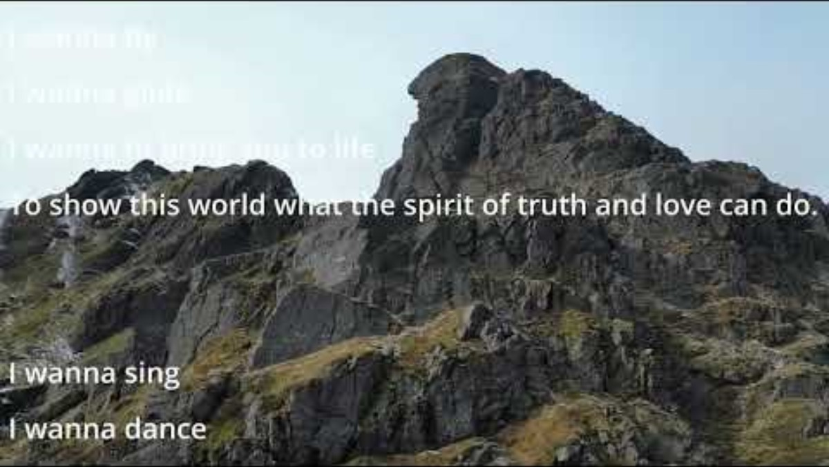
Faiths Journey

Slide 4
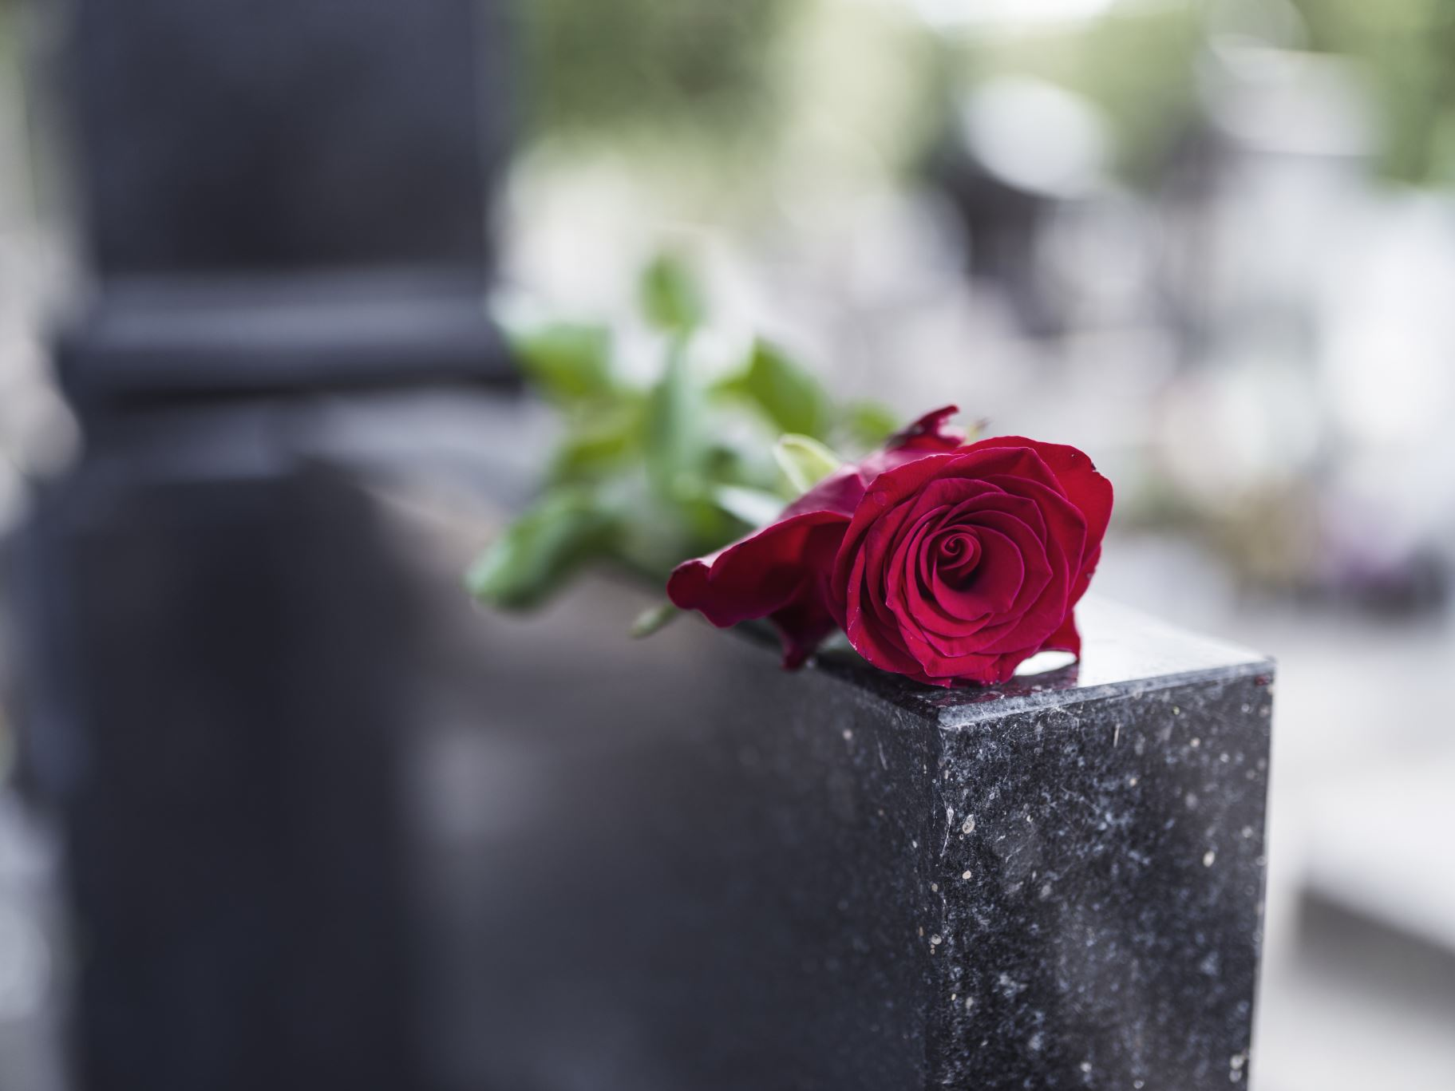
Remembrance Day: Honoring the Past, Inspiring the Future
Welcome to our Boys' Brigade talk on Remembrance Day.

Slide 5
What is Remembrance Day?

Slide 6
What is Remembrance Day?
Observed on 11th November each year to mark the end of World War I in 1918.

Slide 7
Why Do We Remember?

Slide 8
Why Do We Remember?
To honour bravery and sacrifice, learn from history, and promote peace.
John 15:13 - 'Greater love has no one than this: to lay down one’s life for one’s friends.'

Slide 9

Reflections
- How does Jesus’ teaching about love and sacrifice (John 15:13) inspire us to live today?
- Romans 12:18 says, 'If it is possible, as far as it depends on you, live at peace with everyone.' What does peace look like in your life?
- How can we be peacemakers in our school, family, or community?

Slide 10
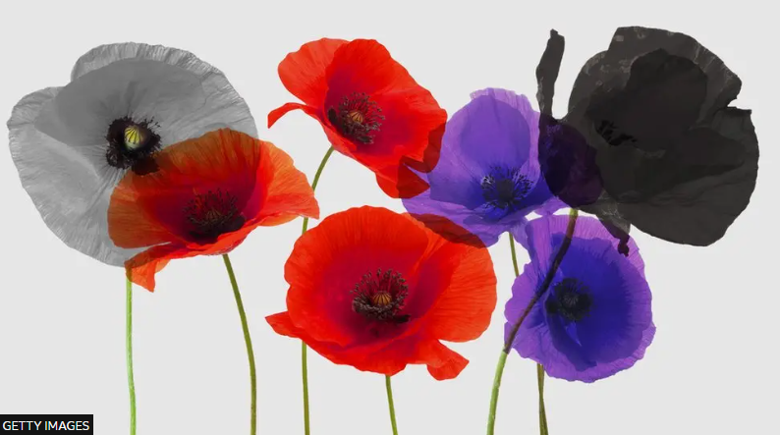
Symbols of the Poppy

Slide 11
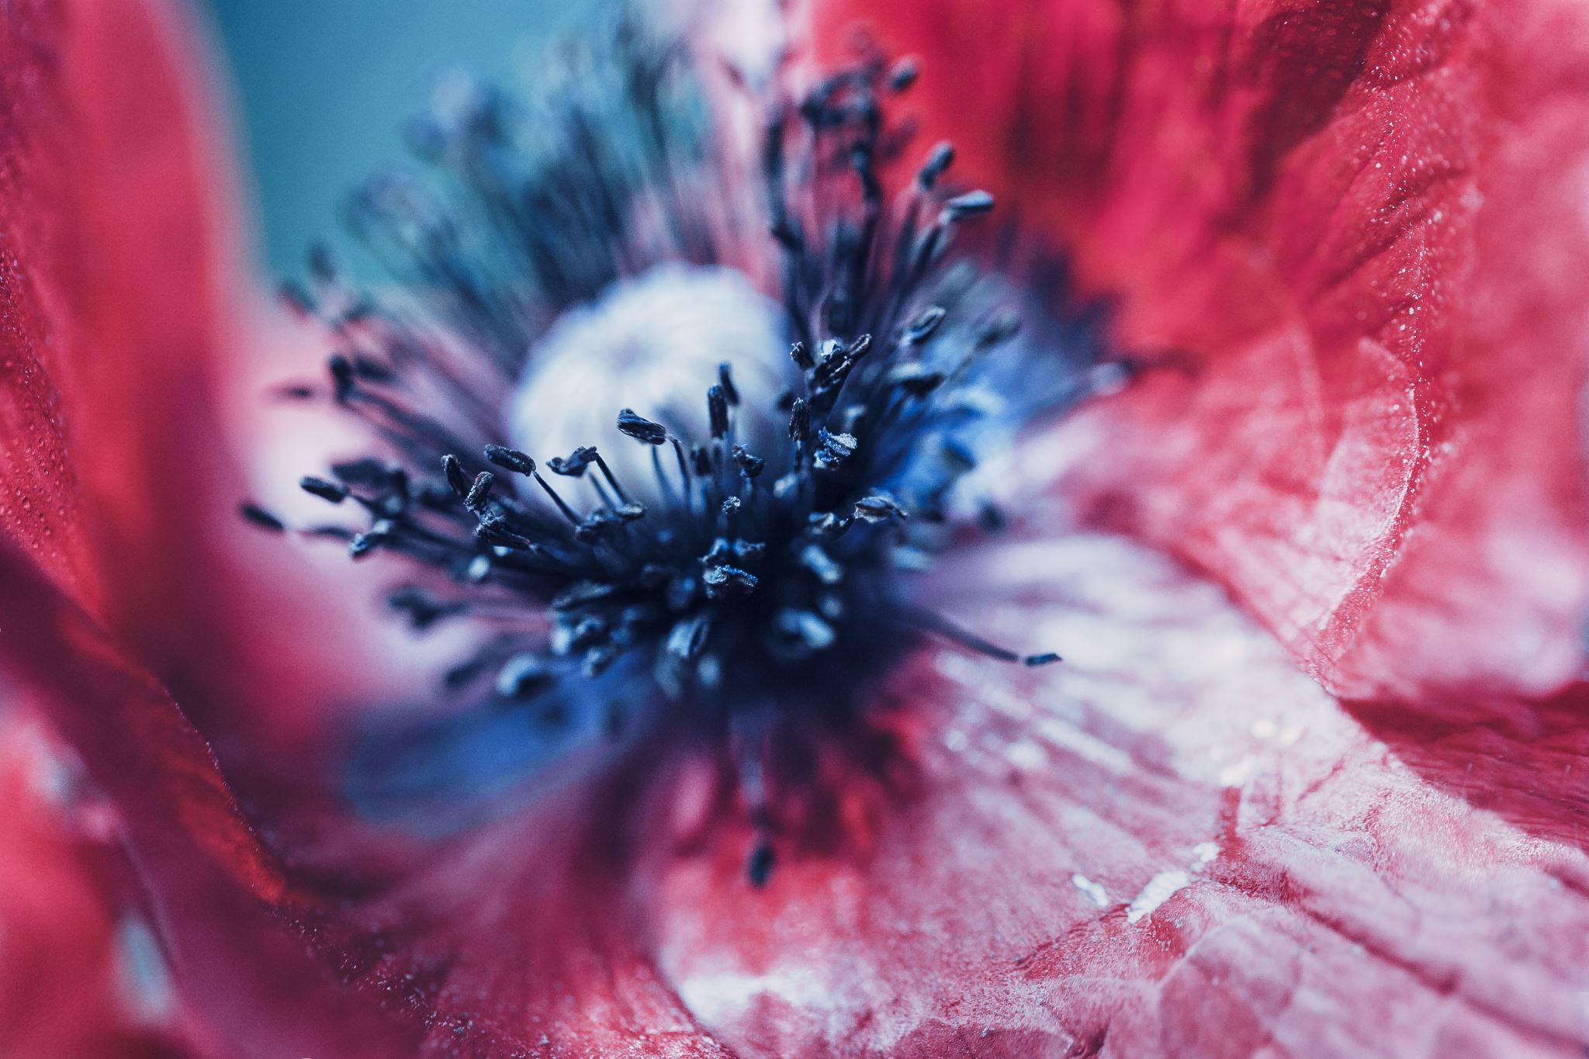
The Symbols of the Poppy
Red poppy for remembrance.
White for peace.
Purple for animals in war.
The Black Poppy commemorates the contributions of black, African and Caribbean communities to the war effort - as servicemen and servicewomen, and as civilians.
The charitable organisation was launched in 2010 and aims to highlight "largely untold historical legacies" from the 16th century onwards

Slide 12
Stories of Courage
Port Glasgow Toll Boys
Joshua 1:9 - 'Be strong and courageous. Do not be afraid; do not be discouraged, for the Lord your God will be with you wherever you go.'

Slide 13
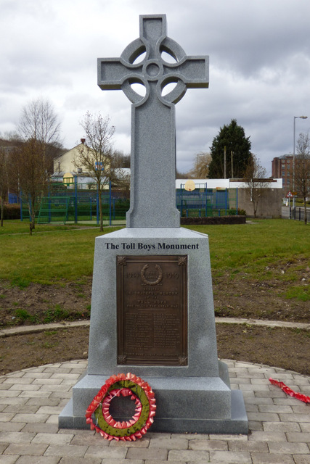
Port Glasgow Toll Boys
Port Glasgow Toll Boys Memorial
The Toll Boys War Memorial in Port Glasgow is a poignant tribute to the 29 local men who fought in World War 1 and sadly did not return. The memorial, located on the site of the former Toll House, features a bronze tablet with their names and an inscription that honours their memory.
It was unveiled on September 3, 1921, by Mr. John Lewis, a Royal Engineer who lost both legs during the war. The memorial serves as a reminder of the sacrifices made by the Toll Boys and the impact of war on their loves and the community.

Slide 14
The Role of the Boys' Brigade
BB members have served in wars and promote values of faith and service.
1 Corinthians 16:13 - 'Be on your guard; stand firm in the faith; be courageous; be strong.'

Slide 15
BB Members who served in conflicts
Piper Bill Millin: An ex-member of a Glasgow BB company, he became famous for playing the pipes as he landed on the beaches of Normandy during the D-Day attacks in June 1944.
Sergeant John Hannah: A former member of the 237th Glasgow BB, he was awarded the Victoria Cross (VC) for his gallantry.
Rev. Herbert Reid: A significant figure in the Port Glasgow BB, he was the minister of Hamilton Church and a military chaplain who won the Military Cross (M.C.) during the First World War while serving with the Highland Division. After the war, he founded the Port Glasgow Old Boys' Union (OBU

Slide 16
How Can We Remember?

Slide 17
How Can We Remember?
Two-minute silence, wearing a poppy, visiting memorials, acts of kindness.

Slide 18
Reflection Moment
Think about freedom, service, and peace.
Philippians 4:7 - 'And the peace of God, which transcends all understanding, will guard your hearts and your minds in Christ Jesus.'

Slide 19
We Will Remember Them!
Romans 12:18 - 'If it is possible, as far as it depends on you, live at peace with everyone.'

Slide 20
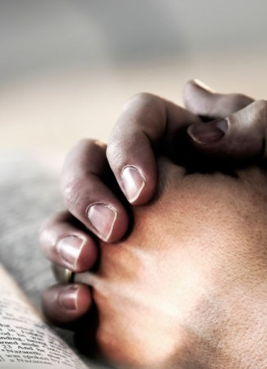
Closing Prayer
Dear Lord,
On this Remembrance Day, we thank You for the courage and sacrifice of those who served.
Help us to honor their memory by living lives of peace, kindness, and service.
May we be inspired by their example to stand for what is right and care for one another.
Grant us the strength to be peacemakers in our world.
In Jesus’ name we pray,
Amen.

